Slide 1
Animation Challenges!
Notes:
Make my title bounce in, change the background

Slide 2
Notes:
Let’s Fix this! Can we remove the background from the school? Can we make the sun set? Can we make the moon rise? Can we make the sky go dark?

Slide 3
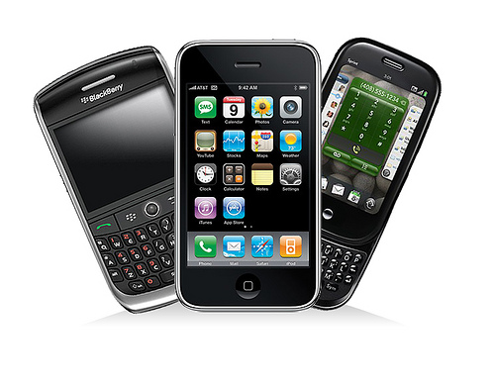
Little Goat Design Company
You are hired by Little Goat Design Company, to create working buttons for four new apps they are developing for their smart phone graphics department.
Project Overview: The first button is a toaster app for Kenmore’s smart phone ad. The second button is being designed for the NBA. The third is for NASA kids club. And the fourth is for the CEO of Little Goat.

Slide 4
Today’s Challenges
Create an animated button of a toaster, that pops toast out of it when you click on it.
Create an animated button that triggers a basketball to bounce on your screen.
Create an animated button, that illustrates this joke:
What do astronauts do when they get angry? Blast off
Create an animated button one on your own.
When you are done, please show me your work. Then work on typing.com or unfished projects. ☺

Slide 5
Notes:
Toaster Challenge: Find a picture of a toaster, and a piece of toast (bagel, pop tart etc…) and animate it to pop out of the toaster. Set up a nice kitchen scene.

Slide 6
Notes:
SPORTS Challenge: Make a basketball player shoot a ball into a hoop… or pick a sport of your choice

Slide 7
Notes:
Space Joke: Animate “What do astronauts do when they get angry?” They blast off!

Slide 8
Notes:
Animators Choice…. IMPRESS Me. Make a phone that opens apps. Make a character that switches their shoes when you press a button, something fun and unique.

